Slide 1
Exam II Review Problem
Believe it or not, the temperatures last night in 9 small towns in Iowa were as follows:
10, 8, 6, 7, 0, 5, 8, 5, 8
Construct a 90% confidence interval for estimating the mean temperature for all Iowa towns last night. (Assume population is normally distributed.)

Slide 2
CHAPTER 11
CHI-SQUARE TESTS
Prem Mann, Introductory Statistics, 8/E Copyright © 2013 John Wiley & Sons. All rights reserved.

Slide 3
THE CHI-SQUARE DISTRIBUTION
Definition
The chi-square distribution has only one parameter called the degrees of freedom. The shape of a chi-squared distribution curve is skewed to the right for small df and becomes symmetric for large df. The entire chi-square distribution curve lies to the right of the vertical axis. The chi-square distribution assumes nonnegative values only, and these are denoted by the symbol χ² (read as “chi-square”).
Prem Mann, Introductory Statistics, 8/E Copyright © 2013 John Wiley & Sons. All rights reserved.

Slide 4
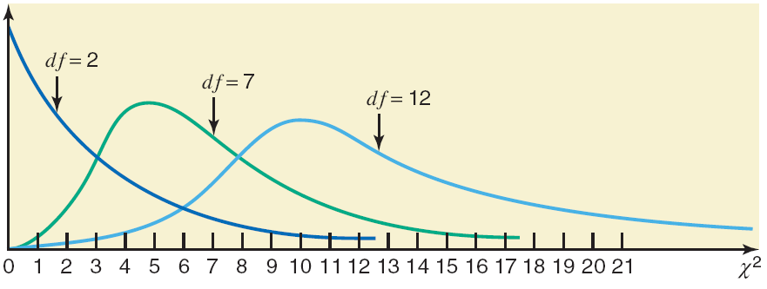
Figure 11.1 Three chi-square distribution curves.
Prem Mann, Introductory Statistics, 8/E Copyright © 2013 John Wiley & Sons. All rights reserved.

Slide 5
Example 11-1
Find the value of χ² for 7 degrees of freedom and an area of .10 in the right tail of the chi-square distribution curve.
Prem Mann, Introductory Statistics, 8/E Copyright © 2013 John Wiley & Sons. All rights reserved.

Slide 6
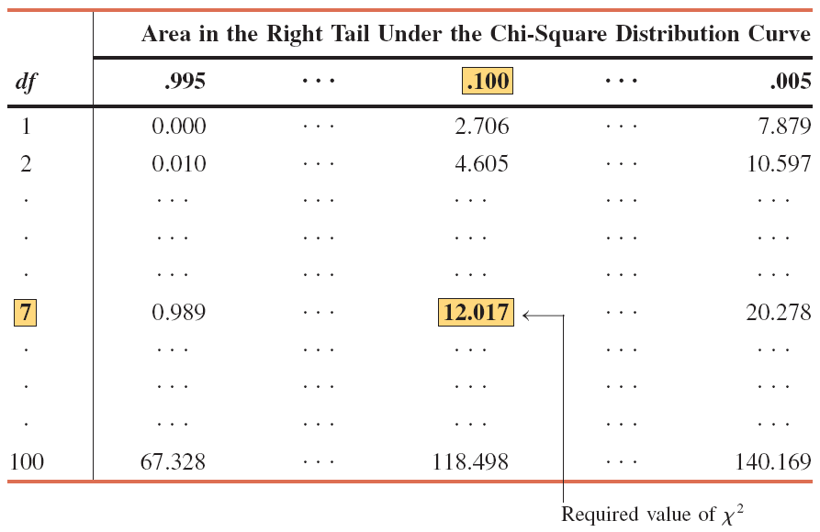
Table 11.1 χ² for df = 7 and .10 Area in the Right Tail
Prem Mann, Introductory Statistics, 8/E Copyright © 2013 John Wiley & Sons. All rights reserved.

Slide 7
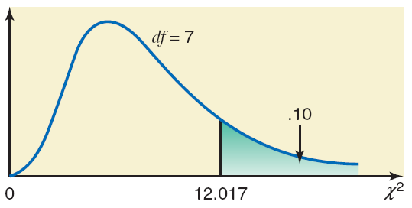
Figure 11.2
Prem Mann, Introductory Statistics, 8/E Copyright © 2013 John Wiley & Sons. All rights reserved.

Slide 8
A GOODNESS-OF-FIT TEST
Definition
An experiment with the following characteristics is called a multinomial experiment.
1. It consists of n identical trials (repetitions).
2. Each trial results in one of k possible outcomes (or categories), where k > 2.
3. The trials are independent.
4. The probabilities of the various outcomes remain constant for each trial.
Prem Mann, Introductory Statistics, 8/E Copyright © 2013 John Wiley & Sons. All rights reserved.

Slide 9
A GOODNESS-OF-FIT TEST
Definition
The frequencies obtained from the performance of an experiment are called the observed frequencies and are denoted by O. The expected frequencies, denoted by E, are the frequencies that we expect to obtain if the null hypothesis is true. The expected frequency for a category is obtained as
E = np
where n is the sample size and p is the probability that an element belongs to that category if the null hypothesis is true.
Prem Mann, Introductory Statistics, 8/E Copyright © 2013 John Wiley & Sons. All rights reserved.

Slide 10
A GOODNESS-OF-FIT TEST
Degrees of Freedom for a Goodness-of-Fit Test
In a goodness-of-fit test, the degrees of freedom are
df = k – 1
where k denotes the number of possible outcomes (or categories) for the experiment.
Prem Mann, Introductory Statistics, 8/E Copyright © 2013 John Wiley & Sons. All rights reserved.

Slide 11
Test Statistic for a Goodness-of-Fit Test
The test statistic for a goodness-of-fit test is χ² and its value is calculated as
where
  O = observed frequency for a category
  E = expected frequency for a category = np
Remember that a chi-square goodness-of-fit test is always right-tailed.
Prem Mann, Introductory Statistics, 8/E Copyright © 2013 John Wiley & Sons. All rights reserved.

Slide 12
Example 11-3
A bank has an ATM installed inside the bank, and it is available to its customers only from 7 AM to 6 PM Monday through Friday. The manager of the bank wanted to investigate if the percentage of transactions made on this ATM is the same for each of the 5 days (Monday through Friday) of the week. She randomly selected one week and counted the number of transactions made on this ATM on each of the 5 days during this week. The information she obtained is given in the following table, where the number of users represents the number of transactions on this ATM on these days. For convenience, we will refer to these transactions as “people” or “users.”
Prem Mann, Introductory Statistics, 8/E Copyright © 2013 John Wiley & Sons. All rights reserved.

Slide 13
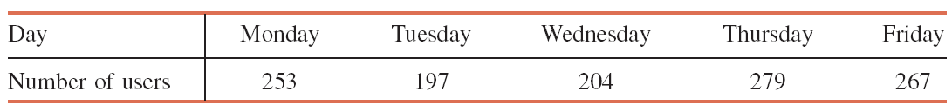
Example 11-3
At the 1% level of significance, can we reject the null
hypothesis that the number of people who use this ATM
each of the 5 days of the week is the same? Assume that
this week is typical of all weeks in regard to the use of this
ATM.
Prem Mann, Introductory Statistics, 8/E Copyright © 2013 John Wiley & Sons. All rights reserved.

Slide 14
Example 11-3: Solution
Step 1:
H₀ : p₁ = p₂ = p₃ = p₄ = p₅ = .20
H₁ : At least two of the five proportions are not equal to .20
Prem Mann, Introductory Statistics, 8/E Copyright © 2013 John Wiley & Sons. All rights reserved.

Slide 15
Example 11-3: Solution
Step 2:
There are 5 categories
  5 days on which the ATM is used
  Multinomial experiment
We use the chi-square distribution to make this test.
Prem Mann, Introductory Statistics, 8/E Copyright © 2013 John Wiley & Sons. All rights reserved.

Slide 16
Example 11-3: Solution
Step 3:
Area in the right tail = α = .01
k = number of categories = 5
df = k – 1 = 5 – 1 = 4
The critical value of χ² = 13.277
Prem Mann, Introductory Statistics, 8/E Copyright © 2013 John Wiley & Sons. All rights reserved.

Slide 17
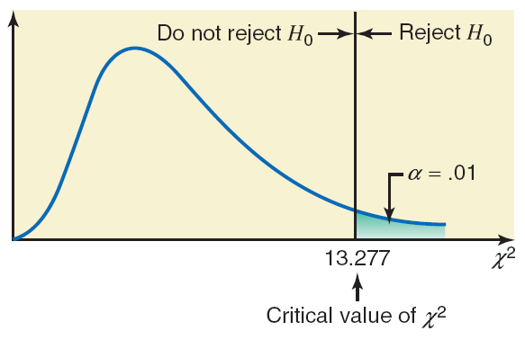
Figure 11.4
Prem Mann, Introductory Statistics, 8/E Copyright © 2013 John Wiley & Sons. All rights reserved.

Slide 18
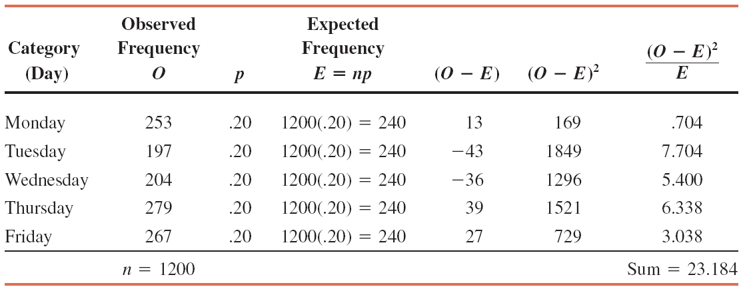
Table 11.3 Calculating the Value of the Test Statistic
Prem Mann, Introductory Statistics, 8/E Copyright © 2013 John Wiley & Sons. All rights reserved.

Slide 19
Example 11-3: Solution
Step 4:
All the required calculations to find the value of the test
statistic χ² are shown in Table 11.3.
Prem Mann, Introductory Statistics, 8/E Copyright © 2013 John Wiley & Sons. All rights reserved.

Slide 20
Example 11-3: Solution
Step 5:
The value of the test statistic χ² = 23.184 is larger than the
critical value of χ² = 13.277.
  It falls in the rejection region
Hence, we reject the null hypothesis.
We state that the number of persons who use this ATM is not
the same for the 5 days of the week.
Prem Mann, Introductory Statistics, 8/E Copyright © 2013 John Wiley & Sons. All rights reserved.

Slide 21
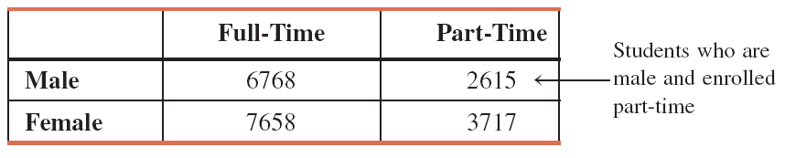
A TEST OF INDEPENDENCE OR HOMOGENEITY
Often we have information on more than one variable for each element. Such information can be summarized and presented using a two-way classification table, which is called a contingency table or cross-tabulation.
Prem Mann, Introductory Statistics, 8/E Copyright © 2013 John Wiley & Sons. All rights reserved.

Slide 22
A TEST OF INDEPENDENCE OR HOMOGENEITY
A Test of Independence
A Test of Homogeneity
Prem Mann, Introductory Statistics, 8/E Copyright © 2013 John Wiley & Sons. All rights reserved.

Slide 23
A Test of Independence
Definition
A test of independence involves a test of the null hypothesis that two attributes of a population are not related. The degrees of freedom for a test of independence are
df = (R – 1)(C – 1)
where R and C are the number of rows and the number of columns, respectively, in the given contingency table.
Prem Mann, Introductory Statistics, 8/E Copyright © 2013 John Wiley & Sons. All rights reserved.

Slide 24
A Test of Independence
Test Statistic for a Test of Independence
The value of the test statistic χ² for a test of independence is calculated as
where O and E are the observed and expected frequencies, respectively, for a cell.
Prem Mann, Introductory Statistics, 8/E Copyright © 2013 John Wiley & Sons. All rights reserved.

Slide 25
Example 11-5
Violence and lack of discipline have become major problems in schools in the United States. A random sample of 300 adults was selected, and these adults were asked if they favor giving more freedom to schoolteachers to punish students for violence and lack of discipline. The two-way classification of the responses of these adults is represented in the following table.
Prem Mann, Introductory Statistics, 8/E Copyright © 2013 John Wiley & Sons. All rights reserved.

Slide 26
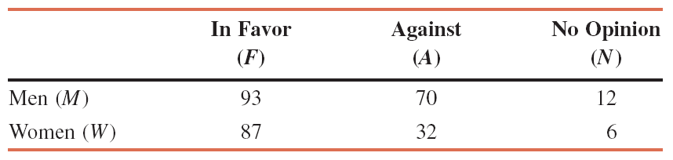
Example 11-5
Calculate the expected frequencies for this table, assuming that the two attributes, gender and opinions on the issue, are independent.
Prem Mann, Introductory Statistics, 8/E Copyright © 2013 John Wiley & Sons. All rights reserved.

Slide 27
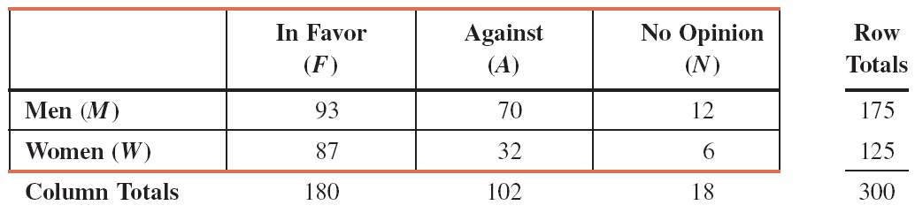
Example 11-5: Solution
Table 11.6 Observed Frequencies
Prem Mann, Introductory Statistics, 8/E Copyright © 2013 John Wiley & Sons. All rights reserved.

Slide 28
Expected Frequencies for a Test of Independence
The expected frequency E for a cell is calculated as
Prem Mann, Introductory Statistics, 8/E Copyright © 2013 John Wiley & Sons. All rights reserved.

Slide 29
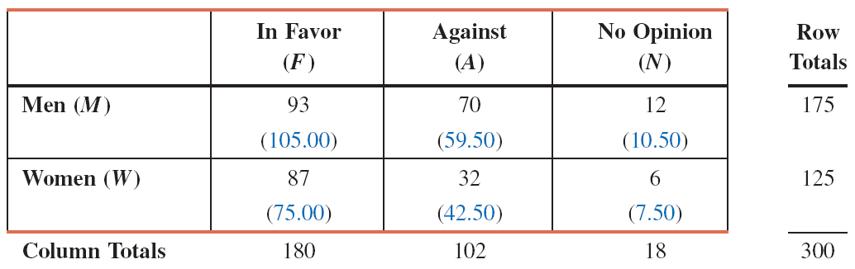
Example 11-5: Solution
Table 11.7 Observed and Expected Frequencies
Prem Mann, Introductory Statistics, 8/E Copyright © 2013 John Wiley & Sons. All rights reserved.

Slide 30
Example 11-6
Reconsider the two-way classification table given in Example 11-5. In that example, a random sample of 300 adults was selected, and they were asked if they favor giving more freedom to schoolteachers to punish students for violence and lack of discipline. Based on the results of the survey, a two-way classification table was prepared and presented in Example 11-5. Does the sample provide sufficient information to conclude that the two attributes, gender and opinions of adults, are dependent? Use a 1% significance level.
Prem Mann, Introductory Statistics, 8/E Copyright © 2013 John Wiley & Sons. All rights reserved.

Slide 31
Example 11-6: Solution
Step 1:
H₀: Gender and opinions of adults are independent
H₁: Gender and opinions of adults are dependent
Prem Mann, Introductory Statistics, 8/E Copyright © 2013 John Wiley & Sons. All rights reserved.

Slide 32
Example 11-6: Solution
Step 2:
We use the chi-square distribution to make a test of independence for a contingency table.
Step 3:
α = .01
df = (R – 1)(C – 1) = (2 – 1)(3 – 1) = 2
The critical value of χ² = 9.210
Prem Mann, Introductory Statistics, 8/E Copyright © 2013 John Wiley & Sons. All rights reserved.

Slide 33
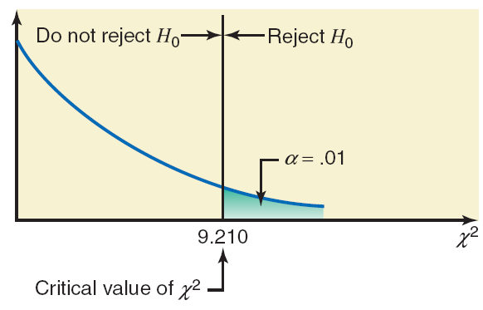
Figure 11.6
Prem Mann, Introductory Statistics, 8/E Copyright © 2013 John Wiley & Sons. All rights reserved.

Slide 34
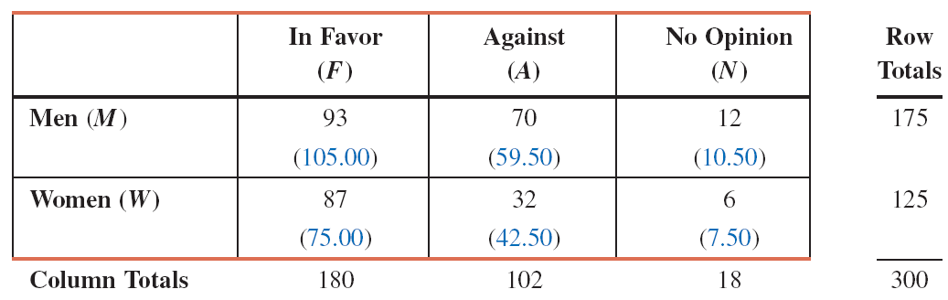
Table 11.8 Observed and Expected Frequencies
Prem Mann, Introductory Statistics, 8/E Copyright © 2013 John Wiley & Sons. All rights reserved.

Slide 35
Example 11-6: Solution
Step 4:
Prem Mann, Introductory Statistics, 8/E Copyright © 2013 John Wiley & Sons. All rights reserved.

Slide 36
Example 11-6: Solution
Step 5:
The value of the test statistic χ² = 8.252
  It is less than the critical value of χ² = 9.210
  It falls in the nonrejection region
Hence, we fail to reject the null hypothesis.
We state that there is not enough evidence from the sample
to conclude that the two characteristics, gender and opinions
of adults, are dependent for this issue.
Prem Mann, Introductory Statistics, 8/E Copyright © 2013 John Wiley & Sons. All rights reserved.

Slide 37
A Test of Homogeneity
Definition
A test of homogeneity involves testing the null hypothesis that the proportions of elements with certain characteristics in two or more different populations are the same against the alternative hypothesis that these proportions are not the same.
Prem Mann, Introductory Statistics, 8/E Copyright © 2013 John Wiley & Sons. All rights reserved.

Slide 38
Example 11-8
Consider the data on income distributions for households in California and Wisconsin given in Table 11.10. Using the 2.5% significance level, test the null hypothesis that the distribution of households with regard to income levels is similar (homogeneous) for the two states.
Prem Mann, Introductory Statistics, 8/E Copyright © 2013 John Wiley & Sons. All rights reserved.

Slide 39
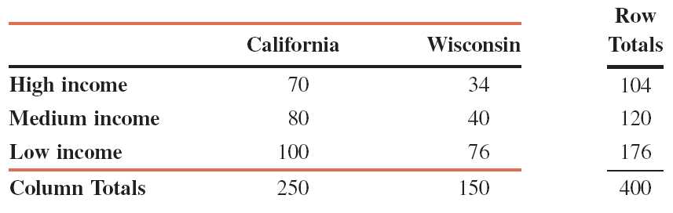
Example 11-8
Table 11.10 Observed Frequencies
Prem Mann, Introductory Statistics, 8/E Copyright © 2013 John Wiley & Sons. All rights reserved.

Slide 40
Example 11-8: Solution
Step 1:
H₀: The proportions of households that belong to different
income groups are the same in both states
H₁: The proportions of households that belong to different
income groups are not the same in both states
Prem Mann, Introductory Statistics, 8/E Copyright © 2013 John Wiley & Sons. All rights reserved.

Slide 41
Example 11-8: Solution
Step 2:
We use the chi-square distribution to make a homogeneity test.
Step 3:
α = .025
df = (R – 1)(C – 1) = (3 – 1)(2 – 1) = 2
The critical value of χ² = 7.378
Prem Mann, Introductory Statistics, 8/E Copyright © 2013 John Wiley & Sons. All rights reserved.

Slide 42
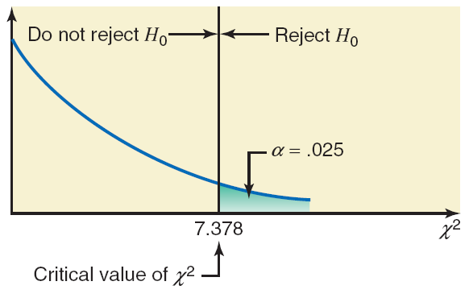
Figure 11.8
Prem Mann, Introductory Statistics, 8/E Copyright © 2013 John Wiley & Sons. All rights reserved.

Slide 43
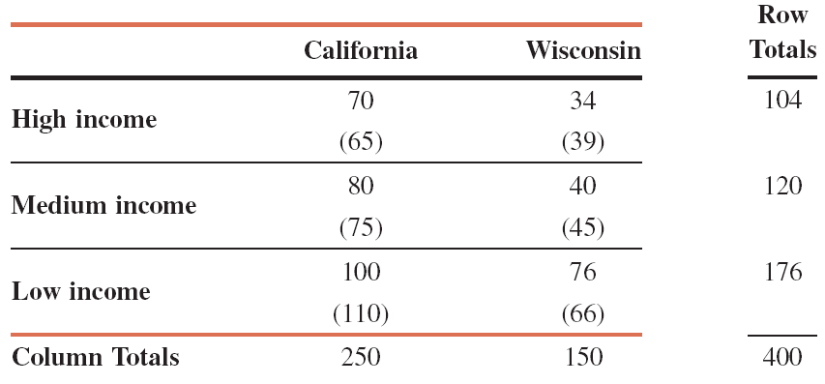
Table 11.11 Observed and Expected Frequencies
Prem Mann, Introductory Statistics, 8/E Copyright © 2013 John Wiley & Sons. All rights reserved.

Slide 44
Example 11-8: Solution
Step 4:
Prem Mann, Introductory Statistics, 8/E Copyright © 2013 John Wiley & Sons. All rights reserved.

Slide 45
Example 11-8: Solution
Step 5:
The value of the test statistic χ² = 4.339
  It is less than the critical value of χ²
  It falls in the nonrejection region
Hence, we fail to reject the null hypothesis.
We state that the distribution of households with regard to
income appears to be similar (homogeneous) in California and
Wisconsin.
Prem Mann, Introductory Statistics, 8/E Copyright © 2013 John Wiley & Sons. All rights reserved.

Slide 46
INFERENCES ABOUT THE POPULATION VARIANCE
Estimation of the Population Variance
Hypothesis Tests About the Population Variance
Prem Mann, Introductory Statistics, 8/E Copyright © 2013 John Wiley & Sons. All rights reserved.

Slide 47
INFERENCES ABOUT THE POPULATION VARIANCE
Sampling Distribution of (n – 1)s² / σ²
If the population from which the sample is selected is (approximately) normally distributed, then
has a chi-square distribution with n – 1 degrees of freedom.
Prem Mann, Introductory Statistics, 8/E Copyright © 2013 John Wiley & Sons. All rights reserved.

Slide 48
Estimation of the Population Variance
Confidence interval for the population variance σ²
Assuming that the population from which the sample is selected is (approximately) normally distributed, we obtain the (1 – α)100% confidence interval for the population variance σ² as
Prem Mann, Introductory Statistics, 8/E Copyright © 2013 John Wiley & Sons. All rights reserved.

Slide 49
Estimation of the Population Variance
where and are obtained from the chi-square distribution for α /2 and 1- α /2 areas in the right tail of the chi-square distribution curve, respectively, and for n-1 degrees of freedom. The confidence interval for the population standard deviation can be obtained by simply taking the positive square roots of the two limits of the confidence interval for the population variance.
Prem Mann, Introductory Statistics, 8/E Copyright © 2013 John Wiley & Sons. All rights reserved.

Slide 50
Hypothesis Tests About the Population Variance
Test statistic for a Test of Hypothesis About σ²
The value of the test statistic χ² is calculated as
where s² is the sample variance, σ² is the hypothesized value of the population variance, and n – 1 represents the degrees of freedom. The population from which the sample is selected is assumed to be (approximately) normally distributed.
Prem Mann, Introductory Statistics, 8/E Copyright © 2013 John Wiley & Sons. All rights reserved.

Slide 51
Example 11-11
The variance of scores on a standardized mathematics test for all high school seniors was 150 in 2011. A sample of scores for 20 high school seniors who took this test this year gave a variance of 170. Test at the 5% significance level if the variance of current scores of all high school seniors on this test is different from 150. Assume that the scores of all high school seniors on this test are (approximately) normally distributed.
Prem Mann, Introductory Statistics, 8/E Copyright © 2013 John Wiley & Sons. All rights reserved.

Slide 52
Example 11-11: Solution
Step 1:
H₀: σ² = 150
  (The population variance is not different from 150)
H₁: σ² ≠ 150
  (The population variance is different from 150)
Prem Mann, Introductory Statistics, 8/E Copyright © 2013 John Wiley & Sons. All rights reserved.

Slide 53
Example 11-11: Solution
Step 2:
We use the chi-square distribution to test a hypothesis
about σ²
Step 3:
α = .05
Area in each tail = .025
df = n – 1 = 20 – 1 = 19
The critical values of χ² = 32.852 and 8.907
Prem Mann, Introductory Statistics, 8/E Copyright © 2013 John Wiley & Sons. All rights reserved.

Slide 54
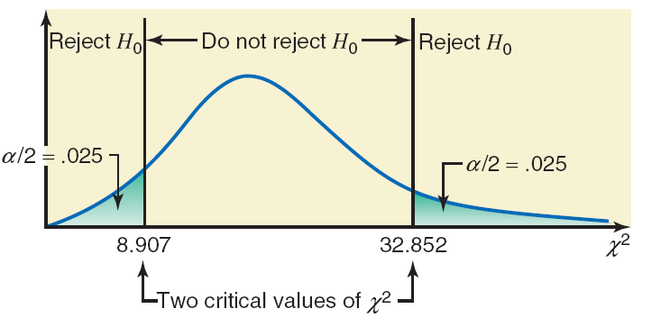
Figure 11.11
Prem Mann, Introductory Statistics, 8/E Copyright © 2013 John Wiley & Sons. All rights reserved.

Slide 55
Example 11-11: Solution
Step 4:
From H₀
Prem Mann, Introductory Statistics, 8/E Copyright © 2013 John Wiley & Sons. All rights reserved.

Slide 56
Example 11-11: Solution
Step 5:
The value of the test statistic χ² = 21.533
  It is between the two critical values of χ²
  It falls in the nonrejection region
Consequently, we fail to reject H₀.
We conclude that the population variance of the current
scores of high school seniors on this standardized
mathematics test does not appear to be different from 150.
Prem Mann, Introductory Statistics, 8/E Copyright © 2013 John Wiley & Sons. All rights reserved.

Slide 57

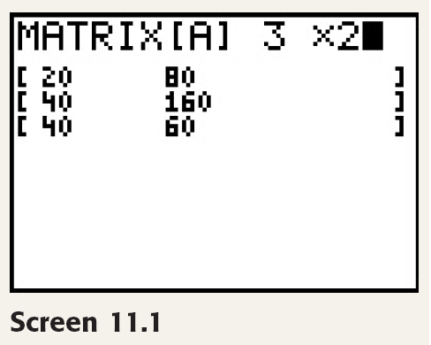
TI-84
Prem Mann, Introductory Statistics, 8/E Copyright © 2013 John Wiley & Sons. All rights reserved.

Slide 58
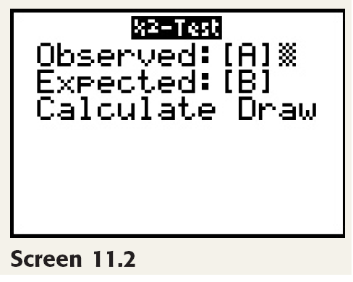
TI-84
Prem Mann, Introductory Statistics, 8/E Copyright © 2013 John Wiley & Sons. All rights reserved.

Slide 59
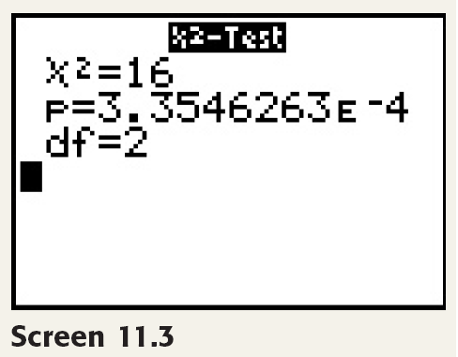
TI-84
Prem Mann, Introductory Statistics, 8/E Copyright © 2013 John Wiley & Sons. All rights reserved.

Slide 60
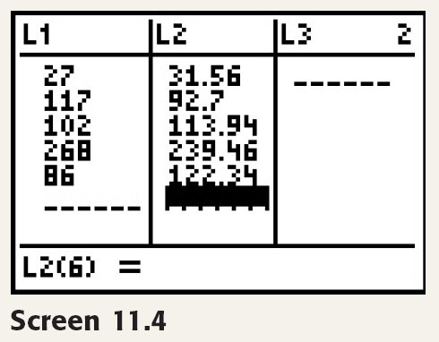
TI-84
Prem Mann, Introductory Statistics, 8/E Copyright © 2013 John Wiley & Sons. All rights reserved.

Slide 61
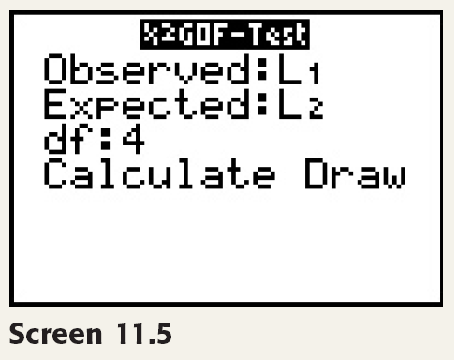
TI-84
Prem Mann, Introductory Statistics, 8/E Copyright © 2013 John Wiley & Sons. All rights reserved.

Slide 62
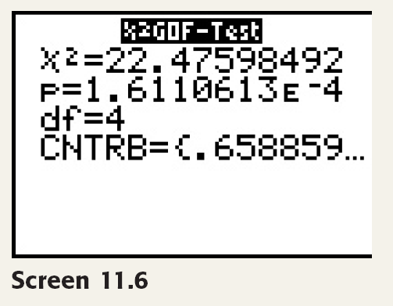
TI-84
Prem Mann, Introductory Statistics, 8/E Copyright © 2013 John Wiley & Sons. All rights reserved.

